Slide 1

AI-DS Project
DAP391m

Slide 2
Prerequisites
  Completed:
    PFP191
    ADY201m
Course Introduction

Slide 3
Course Objectives
Understand the basics of data analysis with Python to build and evaluate data models.
Understand how to import data from multiple sources, clean and wrangle data, perform exploratory data analysis (EDA), and create meaningful data visualizations.
Know different ways to effectively visualize both small and large-scale data
Course Introduction

Slide 4
Course Objectives
Implement various types of basic and advanced graphs and charts like Waffle Charts, Area Plots, Histograms, Bar Charts, Pie Charts, Scatter Plots, Word Clouds, Choropleth Maps,….
Implement an application that leverages multiple Watson AI services (Discovery, Speech to Text, Assistant, and Text to Speech)
Course Introduction

Slide 5
Course Objectives
Implement an application that leverages multiple Watson AI services (Discovery, Speech to Text, Assistant, and Text to Speech)
Implement different techniques to develop applications and AI-powered solutions.
Implement the small mini capstone data science project
Course Introduction

Slide 6
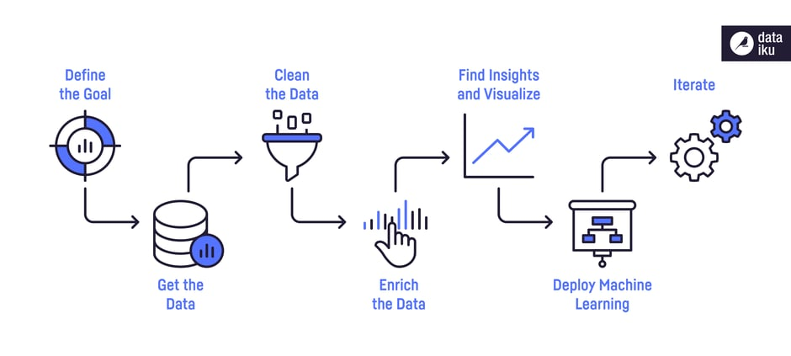

Course Objectives
Data Science Process
Course Introduction

Slide 7
Course Plan
Data Analysis with Python: importing datasets, data wrangling, exploratory Data Analysis, model development, model evaluation
Lab 1: Data Analysis with Python
Course Introduction

Slide 8
Course Plan
Introduction to Data Visualization Tools
Basic and Specialized Visualization Tools
Advanced Visualizations and Geospatial Data
Creating Dashboards with Plotly and Dash
Lab 2, 3: Data Visualization with Python
Course Introduction

Slide 9
Course Plan
Building AI Applications with Watson APIs: introduction, voice to text, deployment
Lab 4: Building AI Applications with Watson APIs: chat bot, deploy on facebook and slack
Course Introduction

Slide 10
Course Plan
Quiz
Applied Data Science Capstone: introduction, interactive visual analytics and dashboard, predictive analysis (classification), present your data-driven insights
Lab 5: Applied Data Science
Course Introduction

Slide 11
Course Plan
Assignment grading
Review course
Course Introduction

Slide 12
Materials/ References
Required References- Coursera courses
  Python Project for Data Science
  Data Analysis with Python
  Data Visualization with Python
  Building AI Applications with Watson APIs
  Applied Data Science Capstone
Course Introduction

Slide 13
Learning Environments
GitHub, Jupyter Notebooks, and Google colab
Watson Studio.
Course Introduction

Slide 14
Course Rules
How to conduct
  Prepare contents of the next session/ topic at home
  Following lessons in classrooms
  Completing chapter assessments in time and Quizzes
Communication
  Class/Interchange by FU-HCM CMS, Forum
  Discussing actively in your teams and in classrooms
Course Introduction

Slide 15
Evaluation Strategy
Must attend more than 80% of contact hours
(if not, not allow to take exam).
Evaluating
  01 Progress Test (Q) 10 %
  Labs 30 %
  Assignment 30%
  Final Exam (FE) 30 %
Total score
  10% (Qiz)+ 30%( lab) + 30% (Assignment) + 30% (FE)
Pass
  Total score ≥ 5 and Final Examination ≥ 4 (of 10)
  Every components > 0
Course Introduction

Slide 16
How to study
This course is complex knowledge (however, it’s attractive and exciting), so you need to keep tight grip on it
  Read
    On the books to get the general concept
    Reference, study, collection from anywhere else (internet, your classmates, forum …)
  Attend lectures
    Listens, understand, then make your own notes
    Give your explanation about some topic in lectures/ Ask questions
    Give some examples that are not existed in your book
    Practice all the exercises, demo to make your sense
Course Introduction

Slide 17
How to study
  After classes
    Discuss with your classmate in directly, on forum
    Do the lab, assignments to submit via CMS, and do more exercises
    Build your teams in yourselves to support together in studying
Course Introduction

Slide 18
How to exam/test
This course is required following rules, so you need to focus and practice your exercises and homework in try your best everyday
  Progress Tests
    No books
    No conversations
  Workshop/Assignment
    Not copy (copy code, contents, style)
Course Introduction

Slide 19
Academic policy
Cheating, plagiarism and breach of copyright are serious offenses under this Policy.
  Cheating
    Cheating during a test or exam is construed as talking, peeking at another student’s paper or any other clandestine method of transmitting information.
    Cheating during in making lab and assignment as copy source code, copy style, same meaning in progress, …
Course Introduction

Slide 20
Academic policy
Cheating, plagiarism and breach of copyright are serious offenses under this Policy.
  Plagiarism
    Plagiarism is using the work of others without citing it; that is, holding the work of others out as your own work.
  Breach of Copyright
    If you photocopy a textbook without the copyright holder's permission, you violate copyright law.
Course Introduction

Slide 21
Enjoy the Course
Be enthusiastic about the material because it is interesting, useful and an important part of your training.
Our job is to help you learn and enjoy the experience.
We will do our best but we need your help.
So, let’s all have fun together with DAP391m!!!
Course Introduction

Slide 22
Q & A
Course Introduction

